Slide 1




Student Representation at the University of Salford

Slide 2

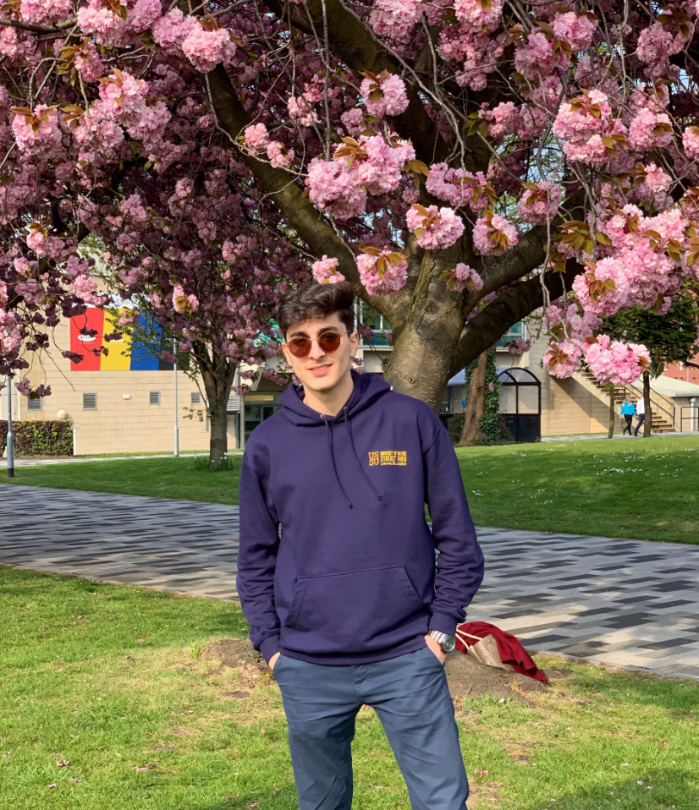
What is Student Representation?
1 SEE Union Officer
1 for the whole School
15 School Reps
1 for each subject area
100’s Course Reps
1 for each level of each Programme
Student feedback
Students
Previous School Rep for Civil Engineering
Notes:
The University of Salford really care about student voice. Lecturers and Programme Leaders welcome feedback about teaching on your course, which can inform changes to your Programme. To hear feedback from students, each Programme elects/selects a Course Rep. It is there responsibility to talk to their peers and pass along feedback to the Programme Leader. There is a Course Rep for each year of each Programme and they are recruited at the beginning of the academic year. Student feedback can flow all the way to the most senior members of the School. To provide a mechanism for student feedback to be heard by your Director or Subject Head, there are also higher level Reps known as School Reps. For those of you unfamiliar with School Reps, lets find out a bit more…

Slide 3


Could you be the voice for students on your course in the 2020/21 academic year?
Notes:
There are, therefore, 2 different voluntary positions you can put yourself forward for as part of this Student Rep system. These roles are recruited in slightly different ways, as explained at the end of this presentation. There are Course Reps, and School Reps. We will help you decide which position is right for you with the following information…

Slide 4
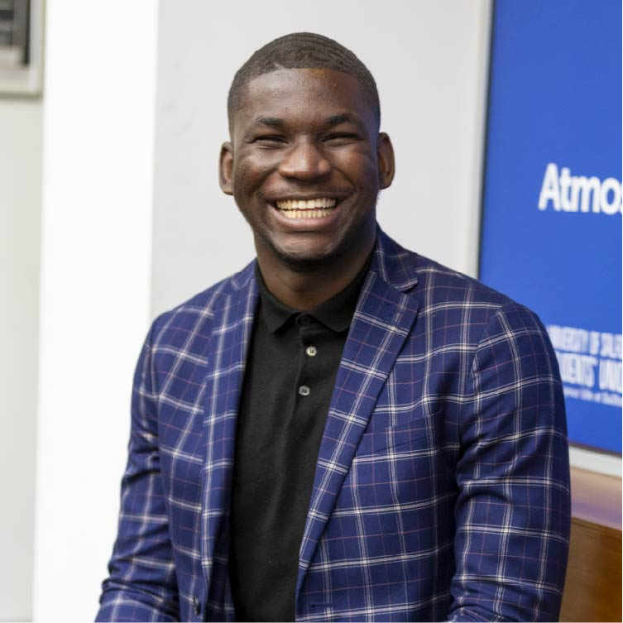
What does being a Course Rep Involve?
Course Reps are the elected spokesperson for their year of their programme.
They are recruited in the first few weeks of the academic year.
They gather feedback from students on their course and propose solutions/changes that could be made.
They attend meetings with their Programme Leader to report student opinion.
Course Reps attend training and relevant events.
Further information and the full role descriptor can be found here: https://www.salfordstudents.com/student-voice/reps/become-a-rep
Previous School Rep in Science, Engineering and Environment
Notes:
So what do Course Reps actually do?
This equates to approximately 1 hour commitment a week.

Slide 5
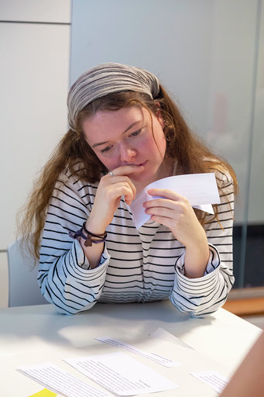
What does being a School Rep Involve?
School Reps represent clusters of Courses. They also provide support to the Course Reps in their subject area.
They are recruited in the spring and any unfilled positions are then recruited in September.
These higher level Reps work with the Head of School to flag and resolve issues that affect multiple courses. They also help foster a sense of community in their school and can run wider campaigns with their Officer.
They have access to a library champion budget to request books for their School.
They take part in Programme reviews.
Further information and a full role descriptor can be found here: https://www.salfordstudents.com/schoolrep
Previous School Rep for Science, Engineering and Environment
Notes:
So what do School Reps actually do?
This equates to approximately 2 hours commitment a week.

Slide 6

What School Rep positions are available?
Architecture & Design
Computer Science
Networking & Electronic Engineering
Mathematics
Notes:
Please note, you can only apply for the School Rep position which is aligned to your course. If you are unsure which School Rep position your course makes you eligible for, please chat to your Programme Leader or email student-representation@salford.ac.uk
Here are the School Rep positions that are vacant in your School – remember this is the more senior Rep role, and is not the same as a Course Rep!

Slide 7
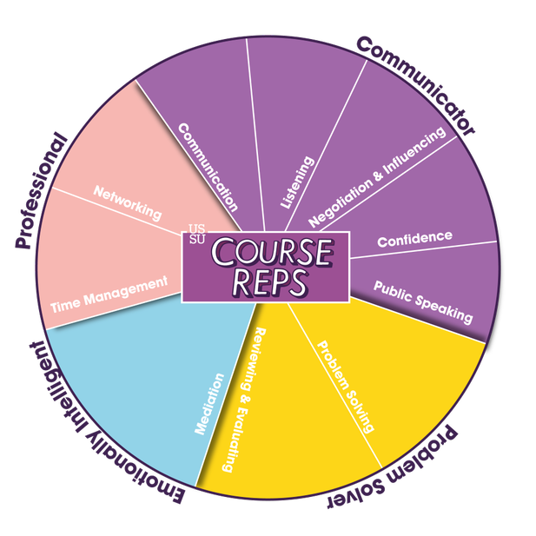
Why should I do it?
Get access to a programme of training opportunities throughout the year. Build skills in public speaking, negotiating and influencing, emotional intelligence, and communication (great for your CV).
Build relationships with academic staff and help foster a community in your School.
Meet new people and socialise with other Reps.
Make large changes within your School and improve the education of countless students.
Notes:
There are loads of great reasons to put yourself forward to become a Rep. Both School Reps and Course Reps gain exclusive access to a year-long programme of training that will develop all the skills you need to make you confident in the role. The Students’ Union will also help you demonstrate how you’ve exercised all these soft skills, making you incredibly employable.
Not only will you benefit from this personal development, but you will also make a HUGE difference to the lives of other students as a Rep and foster a community in your school.
To find out about the training on offer, head here: https://www.salfordstudents.com/student-voice/student-reps/become-a-course-rep/training-skills-development

Slide 8
Interested?
Apply to be a Course Rep:
If you’re interested in representing the students on your specific course, this is for you!
You Programme Leader will ask you to put yourself forward in the first few weeks of the academic year.
They will decide the process for selection – your cohort may vote to appoint you.
Your Programme Leader will then register you with the Students’ Union and you will be invited to compulsory training.

Slide 9
Interested?
Apply to be a School Rep:
If you’re interested in taking on a slightly more senior role and representing several programmes in your subject area, this is for you!
The first round of recruitment took place last Easter but your relevant position might still be vacant.
Fill out an application on the SU website here: salfordstudents.com/schoolrep
You will be invited to a short interview and asked to attend compulsory training.
For any more information on the role of a School Rep, please contact student-representation@salford.ac.uk
Notes:
You can apply by heading to the Students’ Union website (salfordstudents.com/schoolrep) where you will be asked to complete an online application form.
You will then be invited to a short interview.
If successful, you will be asked to attend a compulsory day of training.

Slide 10

Important Dates
School Rep applications close: 6th October
Course Rep registration closes: 13th October
Course Rep training: 18th – 27th October
Notes:
So you know when you need to apply by, here are the key dates for your diaries…

