Slide 1
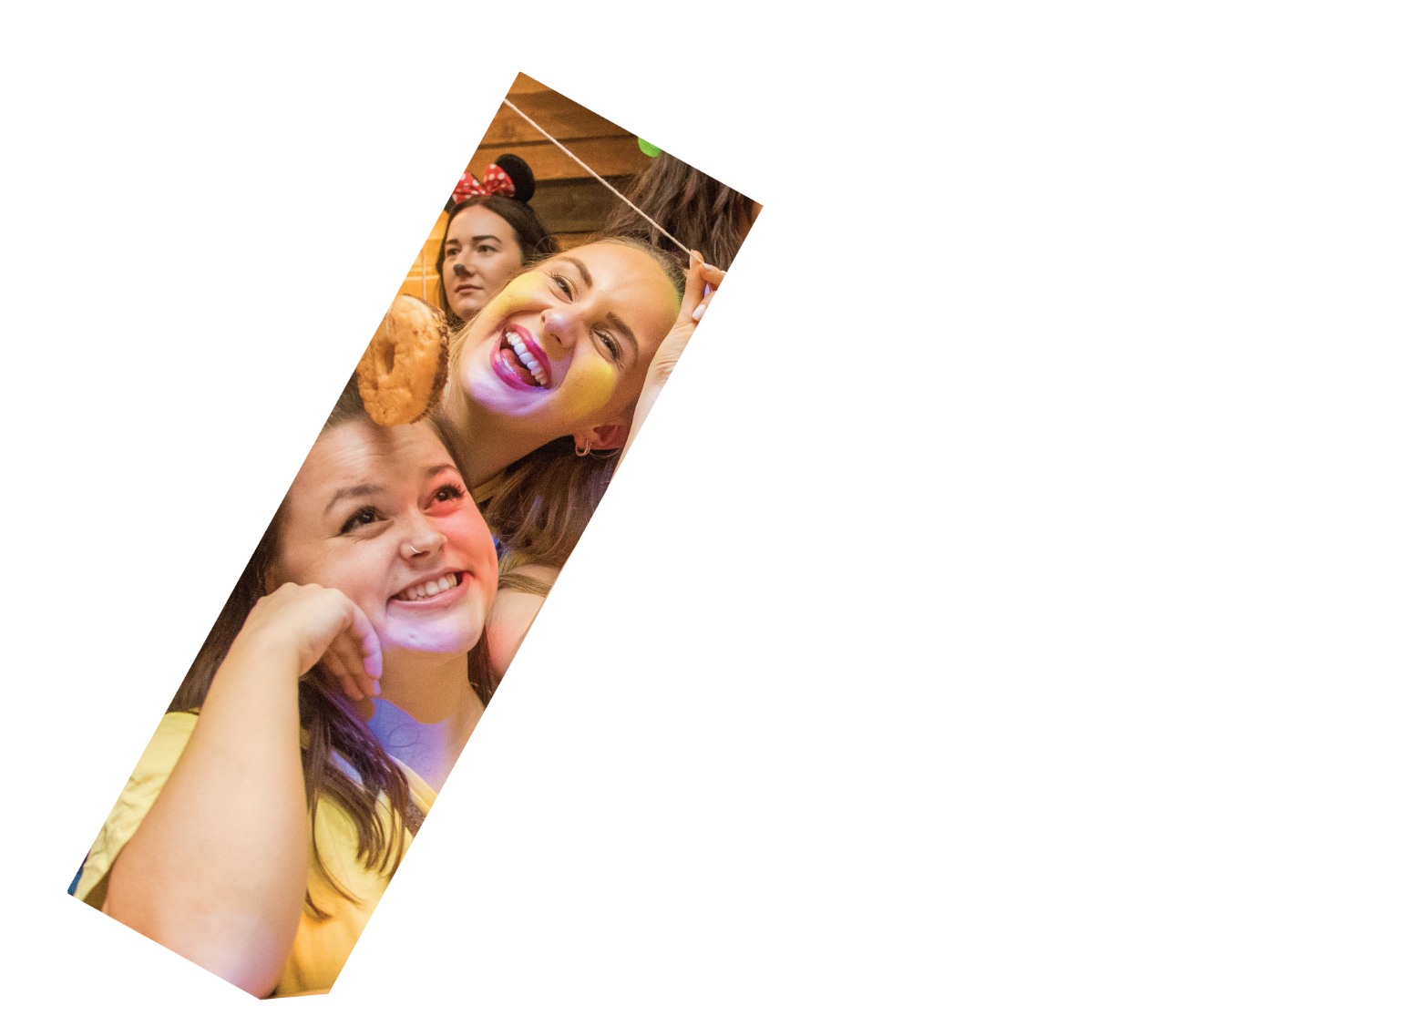



Student Representation at the University of Salford

Slide 2

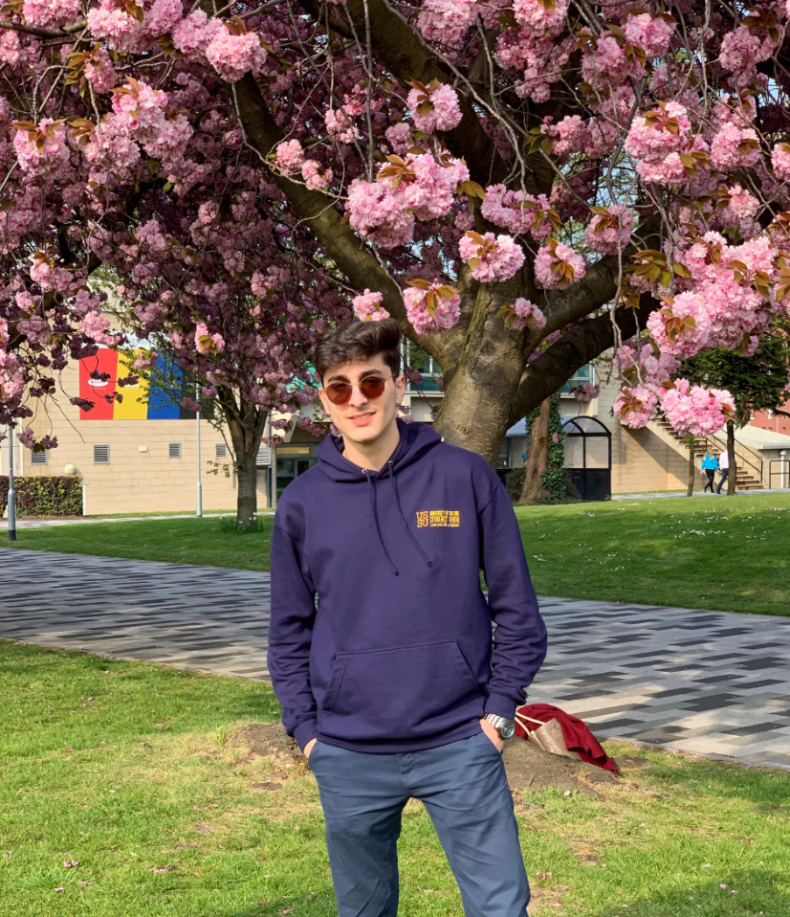
What is Student Representation?
1 Business and Law Union Officer
1 for the whole School
5 School Reps
1 for each subject area
100’s Course Reps
1 for each level of each Programme
Student feedback
Students
Previous School Rep for Civil Engineering
Notes:
The University of Salford really care about student voice. Lecturers and Programme Leaders welcome feedback about teaching on your course, which can inform changes to your Programme. To hear feedback from students, each Programme elects/selects a Course Rep. It is there responsibility to talk to their peers and pass along feedback to the Programme Leader. There is a Course Rep for each year of each Programme and they are recruited at the beginning of the academic year. Student feedback can flow all the way to the most senior members of the School. To provide a mechanism for student feedback to be heard by your Director or Subject Head, there are also higher level Reps known as School Reps. For those of you unfamiliar with School Reps, lets find out a bit more…

Slide 3


Could you be the voice for students on your course in the 2022/23 academic year?
Notes:
There are, therefore, 2 different voluntary positions as part of this Student Rep System. School Reps have been filled for 2022-23 but you can consider these for when we recruit in Easter! These roles are recruited in slightly different ways, as explained at the end of this presentation. There are Course Reps, and School Reps.

Slide 4
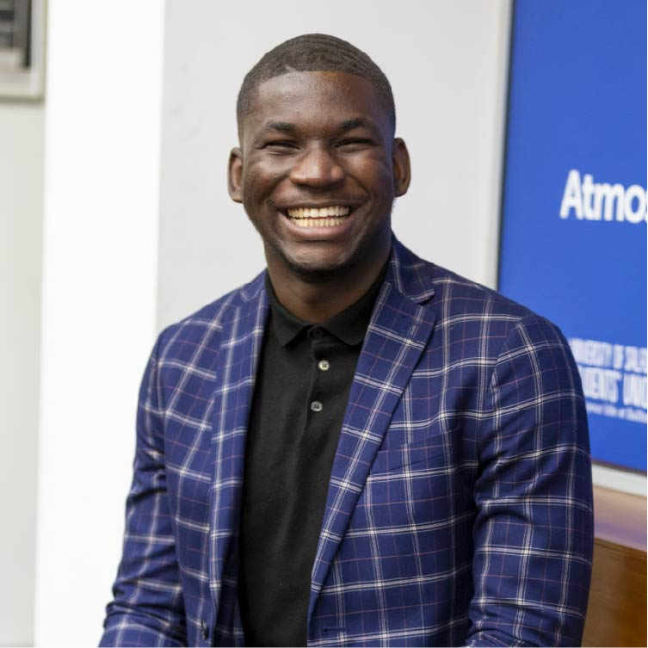
What does being a Course Rep Involve?
Course Reps are the elected spokesperson for their year of their programme.
They are recruited in the first few weeks of the academic year.
They gather feedback from students on their course and propose solutions/changes that could be made.
They attend meetings with their Programme Leader to report student opinion.
Course Reps attend training and relevant events.
Further information and the full role descriptor can be found here: https://www.salfordstudents.com/student-voice/reps/become-a-rep
Previous School Rep in Science, Engineering and Environment
Notes:
So what do Course Reps actually do?
This equates to approximately 1 hour commitment a week.

Slide 5
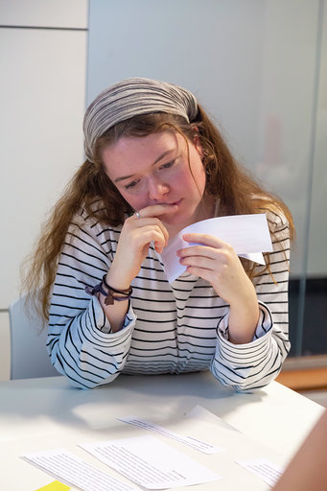
What does being a School Rep Involve?
School Reps represent clusters of Courses. They also provide support to the Course Reps in their subject area.
They are recruited in the spring and positions are already filled for the 2021/22 Academic Year
These higher level Reps work with the Head of School to flag and resolve issues that affect multiple courses. They also help foster a sense of community in their school and can run wider campaigns with their Officer.
They have access to a library champion budget to request books for their School.
They take part in Programme reviews.
Further information and a full role descriptor can be found here: https://www.salfordstudents.com/schoolrep
Previous School Rep for Science, Engineering & Environment
Notes:
So what do School Reps actually do?
This equates to approximately 2 hours commitment a week.
The Business & Law School Rep Positions are filled for 2021/22, but this is something you could consider doing in the next Academic Year!

Slide 6
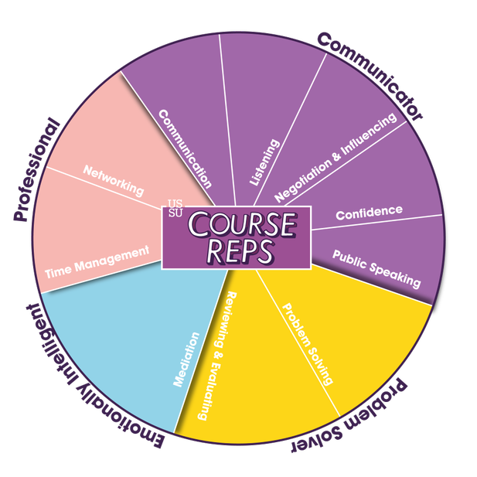
Why should I do it?
Get access to training opportunities. Build skills in public speaking, negotiating and influencing, emotional intelligence, and communication (great for your CV).
Build relationships with academic staff and help foster a community in your School.
Meet new people and socialise with other Reps.
Make large changes within your School and improve the education of countless students.
Notes:
There are loads of great reasons to put yourself forward to become a Rep. Both School Reps and Course Reps gain access training that will develop all the skills you need to make you confident in the role. The Students’ Union will also help you demonstrate how you’ve exercised all these soft skills, making you incredibly employable.
Not only will you benefit from this personal development, but you will also make a HUGE difference to the lives of other students as a Rep and foster a community in your school.

Slide 7
Interested?
Apply to be a Course Rep:
If you’re interested in representing the students on your specific course, this is for you!
You Programme Leader will ask you to put yourself forward in the first few weeks of the academic year.
They will decide the process for selection – your cohort may vote to appoint you.
Your Programme Leader will then register you with the Students’ Union and you will be invited to compulsory training.

Slide 8

Important Dates
Course Rep registration closes: 10th October
Course Rep training: 14th-25th October
Notes:
So you know when you need to apply by, here are the key dates for your diaries…

